Slide 1
Analysis of Simulation Output
Unit 7

Slide 2
Outline
Confidence Intervals and Hypothesis Testing,
Estimation Methods,
Simulation run statistics,
Replication of runs,
Elimination of initial bias

Slide 3
Why analysis of simulation output ?
Many simulation includes some sort of randomness, which can arise in a variety of ways e.g. in a simulation of manufacturing system, the processing times required at a station may have random variations or the arrival times of new jobs may not be known in advance.
In a bank, customers arrive at random times & amount of time spent at a teller is not known beforehand. Because of the randomness of the components driving a simulation, the o/p from simulation is also random. So, statistical techniques must be used to analyze the results.
To test different ideas, to learn about the system behavior in new situation, to learn about simulation model and the corresponding simulation system.

Slide 4
Nature of the problem
Once a stochastic variable has been introduced into simulation model, almost all the system variables describing the system behavior also become stochastic.
Hence it needs some statistical method to analyze the simulation output.
A large body of statistical methods has been developed over the years to analyze results in science, engineering and other fields.
It seem natural to attempt applying these methods to analyze the simulation output but most of them pre-suppose that the results are mutually independent (IID) and the simulation process almost never produce raw output that is IID. For example: customer waiting times from queuing system are not IID. Thus it is difficult to apply classical statistical techniques to analysis of simulation model.

Slide 5
Basic Definitions
Independently and identically distributed random variables:
Usually a random variable is drawn from an infinite population that has probability distribution with finite mean and finite variance. This mean that the population distribution is not affected by the number of sample already made or does it change with time. Further the value of sample is not affected in anyway by value of another sample. Random variables that meet all these conditions are said to be independently and identically distributed.
Central Limit theorem:
The theorem state that the sum of n IID variables drawn from population that has a mean μ of and a variance of 𝜎2 , is approximately distributed as a normal variable with a mean of μ and a variance of n𝜎 2 .

Slide 6
Type of simulation on the basis of output
a) Termination simulation or finite simulation:
The termination of a finite simulation takes place at a specified time or is caused by some specific events. For example: Banks opens at 8:30am with no customers present and 8 of 11 teller working and closed at 4:30 pm. The terminating simulation runs for some specified duration of time TE where E is a specified event that stops the simulation. It starts at time 0 under well specified initial condition and ends at the stooping time TE . For the banking system, the simulation analyst chooses to consider a terminating system because object of interest is one day's operations on the bank.

Slide 7
Type of simulation on the basis of output
b) Non terminating Simulation (Steady state simulation):
The main propose of steady study simulation is the study of long run behavior of system. Performance measure is called a steady state parameter if it is a characteristic of the equilibrium distribution of an output stochastic process. Examples are: Continuously operating communication system where the objective of computation of mean delay of packet in the long run.
(Note: whether a simulation is considered to be terminating or non-terminating depends on both the objective of study and nature of the system)

Slide 8
Type of simulation on the basis of output
Non Terminating Simulation Terminating Simulation
Runs continuously or at least over a very long period of time.
Initial conditions defined by analyst.
Runs for some analyst specified period of time TE
Study the steady state (long run) properties of the system, properties that are not influenced by the initial condition of model.
Runs for some duration of time Te, where e is a specified event that stops the simulation
Starts at time 0 under well-specified initial conditions.
Ends at the stopping time Te
The simulation analyst chooses to consider it a terminating system because the object of interest is one days operation
Example (Bank) : opens at 8:30 am (time 0) with no customers present and 8 of the 11 teller working (initial conditions), and closes at 4:30 pm (Time Te= 480 min)

Slide 9
Confidence Intervals and Hypothesis Testing
Confidence intervals are based on the premise that the data being produced by the simulation is represented well by a probability model.
The confidence interval is the range of possible values for the parameter based on a set of data (simulation results)
A confidence interval displays the probability that a parameter will fall between pair of values around the mean
Confidence intervals measure the degree of uncertainty or certainty in a sampling method

Slide 10
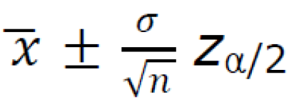
Confidence Intervals and Hypothesis Testing
Suppose the model is the normally distributed with mean 𝑥 , Variance 𝜎2 and we have a sample of n size then the confidence interval is given by:
While characterizing the property of a variable, in every time unit the value changed is compared to predefined intervals known as confidence interval to find similarity between estimated and simulated value
This has a student t-distribution, with n – 1 degree of freedom. Here, the quantity tn-1, α/2 is found on the student t-distribution table

Slide 11

Student-T-Table

Slide 12
Confidence Intervals and Hypothesis Testing
Example : A group of 10 foot surgery patients had a mean weight of 240 pounds. The sample standard deviation was 25 pounds. Find a confidence interval for a sample for the true mean weight of all foot surgery patients. Find a 95% CI.
Step 1: Subtract 1 from your sample size. 10 – 1 = 9. This gives you degrees of freedom, which you’ll need in step 3.
Step 2: Subtract the confidence level from 1, then divide by two. = (1 – .95) / 2 = .025
Step 3: Look up your answers to step 1 and 2 in the t-distribution table. For 9 degrees of freedom (df) and α = 0.025, my result is 2.262.
Step 4: Divide your sample standard deviation by the square root of your sample size.
25 / √(10) = 7.90569415
Step 5: Multiply step 3 by step 4.
2.262 × 7.90569415 = 17.8826802
Step 6: For the lower end of the range , subtract step 5 from the sample mean.
240 – 17.8826802 = 222.117
Step 7: For the upper end of the range, add step 5 to the sample mean.
240 + 17.8826802 = 257.883

Slide 13
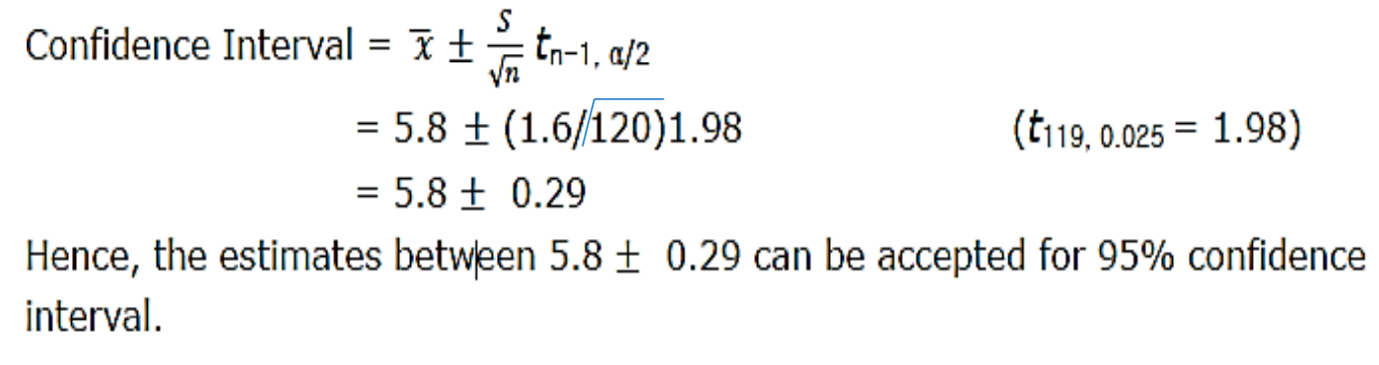
Confidence Intervals and Hypothesis Testing
Example : The daily production time of a product in a factory for 120 days is 5.8 hours and sample standard deviation (S) is 1.6. Calculate confidence interval for 95% confidence level. (where T119, 0.025 = 1.98)

Slide 14
Confidence Intervals and Hypothesis Testing
Homework:
The daily present time in a simulation class for 120 days is 50 minutes and sample standard deviation (S) is 1.6. Calculate confidence interval for 95% confidence level. (T119, 0.025 = 1.98)
The daily present time in a futsal for 120 days is 60 minutes and sample standard deviation (S) is 1.6. Calculate confidence interval for 95% confidence level. (T119, 0.025 = 1.98)

Slide 15
Confidence Intervals and Hypothesis Testing
Hypothesis Testing
A hypothesis is an educated guess about something in the world around you. It should be testable, either by experiment or observation.
Hypothesis testing in statistics is a way for you to test the results of a survey or experiment to see if you have meaningful results. You’re basically testing whether your results are valid by figuring out the odds that your results have happened by chance. If your results may have happened by chance, the experiment won’t be repeatable and so has little use.
The main purpose of statistics is to test a hypothesis. For example, you might run an experiment and find that a certain drug is effective at treating headaches. But if you can’t repeat that experiment, no one will take your results seriously.

Slide 16
Confidence Intervals and Hypothesis Testing
Hypothesis Testing- What is a Hypothesis Statement?
If you are going to propose a hypothesis, it’s customary to write a statement. Your statement will look like this:
“If I…(do this to an independent variable)….then (this will happen to the dependent variable).” For example:
If I (decrease the amount of water given to herbs) then (the herbs will increase in size).
If I (give patients counseling in addition to medication) then (their overall depression scale will decrease).
If I (give exams at noon instead of 7) then (student test scores will improve).
If I (look in this certain location) then (I am more likely to find new species).

Slide 17
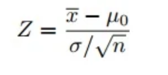
Confidence Intervals and Hypothesis Testing
Hypothesis Testing- Example : A principal at a certain school claims that the students in his school are above average intelligence. A random sample of thirty students IQ scores have a mean score of 112.5. Is there sufficient evidence to support the principal’s claim? The mean population IQ is 100 with a standard deviation of 15.
Step 1: State the Null hypothesis. The accepted fact is that the population mean is 100, so: H₀: μ = 100.
Step 2: State the Alternate Hypothesis. The claim is that the students have above average IQ scores, so: H₁: μ > 100. The fact that we are looking for scores “greater than” a certain point means that this is a one-tailed test.
Step 3: State the alpha level. If you aren’t given an alpha level, use 5% (0.05).
Step 4: Find the rejection region area (given by your alpha level above) from the z-table. An area of .05 is equal to a z-score of 1.645.
Step 5: Find the test statistic using this formula:
For this set of data: z= (112.5 – 100) / (15/√30) = 4.56
Step 6: If Step 5 is greater than Step 4, reject the null hypothesis. If it’s less than Step 4, you cannot reject the null hypothesis. In this case, it is more (4.56 > 1.645), so you can reject the null.

Slide 18
Confidence Intervals and Hypothesis Testing
Hypothesis Testing- Example : Blood glucose levels for obese patients have a mean of 100 with a standard deviation of 15. A researcher thinks that a diet high in raw cornstarch will have a positive or negative effect on blood glucose levels. A sample of 30 patients who have tried the raw cornstarch diet have a mean glucose level of 140. Test the hypothesis that the raw cornstarch had an effect.
Step 1: State the null hypothesis: H0:μ=100
Step 2: State the alternate hypothesis: H1:≠100
Step 3: State your alpha level. We’ll use 0.05 for this example. As this is a two-tailed test, split the alpha into two.
0.05/2=0.025
Step 4: Find the z-score associated with your alpha level. You’re looking for the area in one tail only. A z-score for 0.75(1-0.025=0.975) is 1.96. As this is a two-tailed test, you would also be considering the left tail (z = 1.96)
Step 5: Find the test statistic using this formula:
z = (140 – 100) / (15/√30) = 14.60.
Step 6: If Step 5 is less than -1.96 or greater than 1.96 (Step 3), reject the null hypothesis. In this case, it is greater, so you can reject the null.

Slide 19
Estimation Methods
Estimation method elimates the range for the random variable so that the desired output can be achieved.
To estimate means to find something close to the correct answer
The estimate method gives the desired range of the sample variable taken from infinite population
Infinite population has a stationary probability distribution with a finite mean μ and finite variance σ².
Sample variable and time does not affect population distribution .

Slide 20
Estimation Methods
A random variable is drawn from an infinite population that has a stationary probability distribution with a finite mean μ and finite variance 𝜎 ².
Random numbers that meet all these conditions are said to be IID (Independently and Identically Distributed) variable for which the central limit theorem can be applied.
The theorem states that the sum of 𝑛 IID variable drawn from a population that has mean μ and a variance of 𝜎 ² is approximately distributed as a normal variable with mean 𝑛𝜇 and variance 𝑛 𝜎 ² .
Central limit theorem must be invoked to rely upon normal distribution of infinite population
Only then we can apply estimation method to that variable taken from infinite population. variable taken from infinite population.

Slide 21
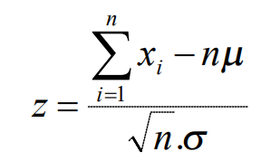
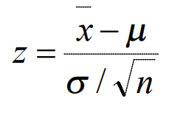
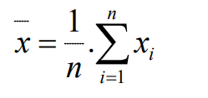
Estimation Methods
Any normal distribution can be transform into a standard distribution that has a mean of 0 and variance of 1.
Let xi (i=1,2,3,……….n) be n IID random variables. Using central limit theorem, we have normal Variate
If, sample mean Then,

Slide 22
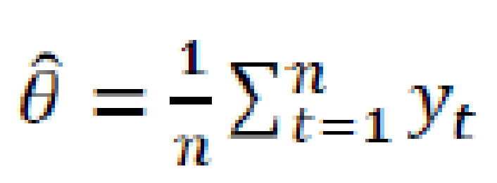
Estimation Methods
Point estimation (For discrete data): Let y1 , y2 ...yn be discrete time data with ordinary mean 𝜃, then point estimator
unbiased if its expected value is 𝜃 i.e. E(𝜃` )= 𝜃
biased if E(𝜃` )≠ 𝜃 and
difference E(𝜃`) - 𝜃 is called bias of 𝜃` .

Slide 23
Estimation Methods
Point estimation (Example): Following are the random sample of height of people of the town. If the population mean is 6.1 ft., find the bias of the point estimator.
We have 𝜃 = 6.1
E(𝜃`) = (5.5 + 6.1 + 5.7 + 6.6 + 5.2 + 6.0 + 5.6 + 6.3 + 5.9 + 5.8)/10 = 5.87
Now, bias of estimator = E(𝜃`) - 𝜃 =5.87 – 6.1 = - 0.23

Slide 24
Estimation Methods
Point estimation (Example): Following are the random sample of marks of student of the orchid college. If the population mean is 51.1 , find the bias of the point estimator.
We have 𝜃 = 6.1
E(𝜃`) = (5.5 + 6.1 + 5.7 + 6.6 + 5.2 + 6.0 + 5.6 + 6.3 + 5.9 + 5.8)/10 = 5.87
Now, bias of estimator = E(𝜃`) - 𝜃 =5.87 – 6.1 = - 0.23

Slide 25
Estimation Methods
How do you use estimation method in simulation output analysis? Explain
The estimation method gives the desired range of the sample variable taken from infinite population. Estimation method in simulation output analysis is used for bias reduction which can be achieved using point estimation and confidence interval.
Explain point estimation and confidence interval with formula and notation
Notes:
any of numerous procedures used to calculate the value of some property of a population from observations of a sample drawn from the population. A point estimate, for example, is the single number most likely to express the value of the property.

Slide 26
Simulation run statistics
In the estimation method, it is assumed that the observations are mutually independent and the distribution from which they are draws is stationary.
Unfortunately many statistics of interest in simulation do not meet these conditions. For example: consider a single server system in which the arrival occurs with poison distribution and service time has an exponential and queue discipline is FIFO.
Where, Poisson distribution means a discrete frequency distribution which gives the probability of a number of independent events occurring in a fixed time.

Slide 27
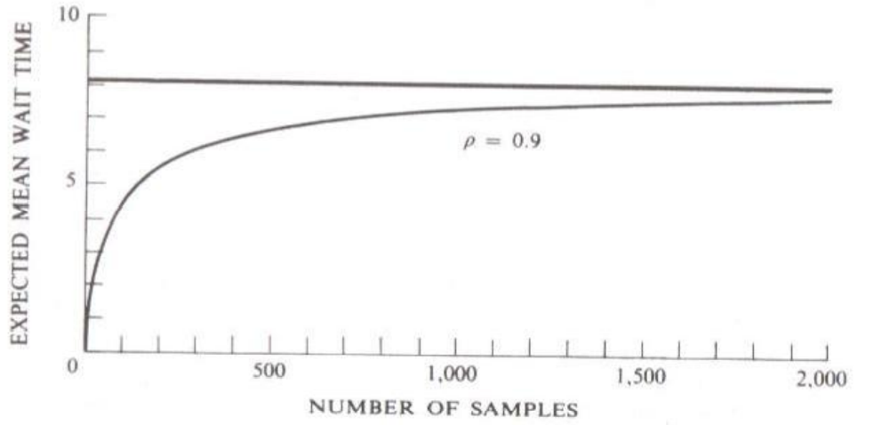
Simulation run statistics
Whenever a waiting line forms, the waiting time of each entity on the line clearly depends upon the waiting time of its predecessors. Such data are called auto-correlated.
Another problem that must be faced is that distribution is not stationary. Early arrivals get the service quickly, so a sample mean that include early arrivals is biased. Large number of simulation runs reduce the bias. The following figure show the mean waiting time for different sample sizes.
Mean wait time in M/M/1 system for different sample size

Slide 28
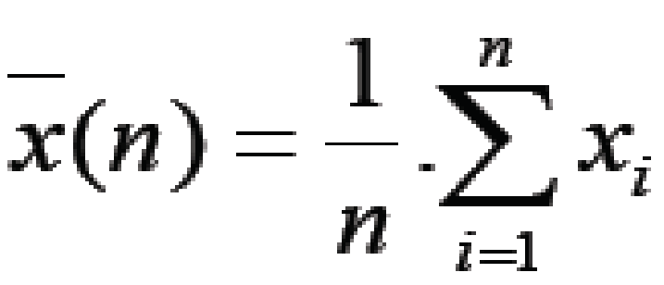
Simulation run statistics
Whenever a waiting line forms the waiting time of each entity on the line depends upon the waiting time of its predecessor. Any series of data that has this property of having one value affect the other values is said to be auto correlated.
The sample mean of auto correlated data can be summed to approximate a normal distribution as the sample size increases.
In simulation run the simplest approach is to estimate the mean waiting time by accumulating the waiting time of 𝑛 successive entities and divide by 𝑛.
This measure the sample mean denoted by 𝑥(̅𝑛). If 𝑥𝑖(𝑖 = 1,2, … … , 𝑛) are the individual waiting time then,

Slide 29
Simulation run statistics
A simulation run is started with the system in some initial state, frequently the idle state in which no service is being given and none entities are waiting. The early arrivals that have a more than normal probability of obtaining service quickly so a sample mean that includes the early arrivals will be biased.
For a given sample size starting from a given initial condition the sample mean distribution is stationery, but if the distribution would be compared for different sample sizes the distribution will be slightly different.
The following figure is based on theoretical results which shows how the expected value of sample mean depends upon the sample length for 𝑀/𝑀/1 system, starting from an initial empty state with a server utilization of 0.9.

Slide 30
Replication of runs
The precision of results of a dynamic stochastic can be increased by repeating the experiment with different random numbers strings.
For each replication of a small sample size, the For each replication of a small sample size, the sample mean is determined.
Repeated no. of simulations generate independent results. The sample means of the independent runs can be further used to estimate the variance of distribution.
One way of obtaining independent result is to repeat simulation. Repeating the experiment with different random numbers for the sample size n gives a set of independent determination of sample mean 𝑥 .
For each simulation run, a different random numbers are used for same sample size ‘n’ and the simulation gives a set of independent determinations of sample mean
Even though the sample mean depends on degree of auto-correlation, the independent determinations can be used to estimate the variance of the distribution

Slide 31
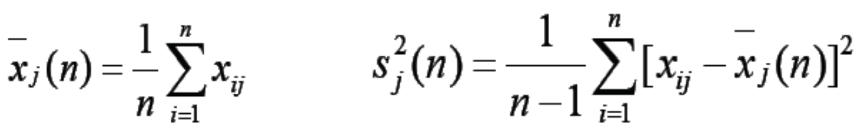
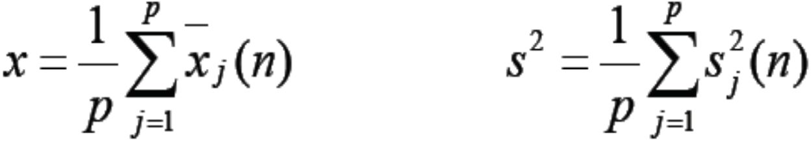
Replication of runs
Suppose the experiment is repeated p times with independent random values of n sample sizes. Let x_{ij} be the i_{th} observation in j_{th} run and let the sample mean and the variance for the j_{th} run is denoted by 𝑥_{j} (n) and 𝑠_{𝑗} ² (𝑛) respectively. Then for j_{th} run, the estimates are
Combining the result of p independent measurement gives the following estimate for the mean 𝑥 and variance s² of the populations as:

Slide 32
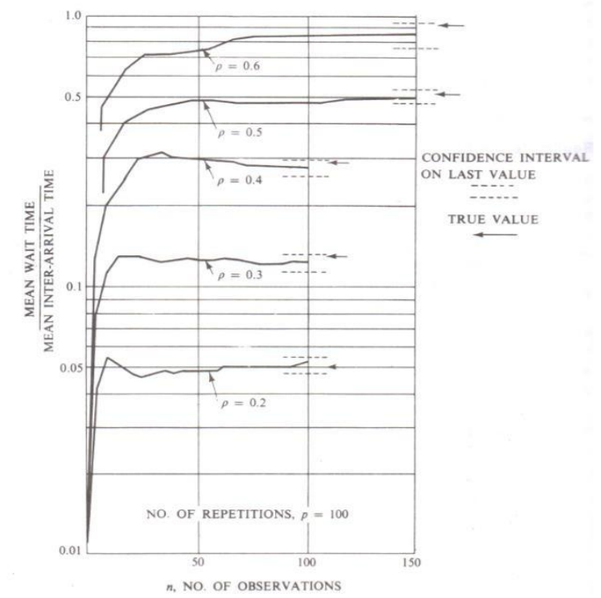
Replication of runs
The following figure shows the result of applying the procedure to experiment results for the 𝑀/𝑀/1 system.

Slide 33
Replication of runs
This variance can further be used in established confidence interval for (𝑝 − 1) degree of freedom.
The length of run of replication is so selected that all compiled combined comes to sample size 𝑁 i.e. 𝑝. 𝑛 = 𝑁,
where 𝑝 = No. of sample
𝑛 = No. of observation per sample
By measuring the number of replications and shortening their length of run, confidence interval can be narrower but due to shortening of length of replication the effect of starting condition will increase.
The result obtained won’t be accurate especially when the initialization of the runs is not proper.
There is not established procedure of dividing the sample size 𝑁 into replications. However it is suggested that the number of replications should not be very large and that the sample means should approximate in normal distribution.

Slide 34
Elimination of initial bias
Two approaches to eliminate initial bias;
System can be started in a more representative state than the empty state
It is necessary to know the steady-state distinction for the system and we then select the initial state distinction.
During the study of the existing simulation system, there may be information about the expected outcome which makes it feasible to select better initial condition and thus eliminating the initial bias.
Or, first part of simulation run can be ignored i.e. take care of those data that come only after steady-state
It is a common approach, where the initial section of run which has high bias result is eliminated

Slide 35
Elimination of initial bias
The ideal situation is to know the steady state distribution for the system and select the initial condition for the distribution.
The more common approach to removing the initial bias is to eliminate an initial section of the run.
The run is started from an idle state and stopped after a certain period of time
The run is then restarted with statistics being gathered from the point of restart.
It is usual to program the simulation so that statistics are gathered from the beginning and simply wipe out the statistics gathered up to the point of restart.
No sample rules can be given beside how long an interval should be eliminated.
Pilot runs – set of runs which are conducted to judge how long the initial bias remains

Slide 36
Elimination of initial bias
Disadvantages of initial bias
The disadvantage of eliminating the first part of the simulation run is that the estimate of the variance needed to estimate a confidence limit, mostly based on less information.
The reduction in bias, therefore, is obtained at the price of increasing the confidence interval size.
More number of pilot runs required
Eliminating the first part of a simulation introduces variance estimate, confidence limit etc. be based on less information

Slide 37
Exercise
Why do we perform the analysis of simulation output? Explain how do you use simulation run statistics in the output analysis.
How do you use estimation method in the analysis of simulation output? Explain in brief.
Define confidence interval and I.I.D in output analysis. How do you use simulation run statistics in simulation output analysis? Explain.
When is estimation method appropriate? Explain.
How do you eliminate the effect of transient and initial bias in simulation output?
Why do we need the analysis of simulation output? How do you use estimation method in output analysis? Explain.
Why Confidence interval is needed in the analysis of simulation output. How can we can we establish a confidence interval?
Explain the replication of runs.

